Slide 1


Green Pace
Security Policy Presentation
Developer: Jacqueline Woods

Slide 2

OVERVIEW: DEFENSE IN DEPTH
DevOps security policy was needed to protect the company from external and internal technological threats as well as to provide an outline for developers to follow to create secure, functional code!

Slide 3
THREATS MATRIX
The Threats Matrix shows some of the many security threats that are facing Dev Ops varying in severity and likeliness. Most of these threats are completely preventable and all these threats can be blocked within the development phase!
Improper Exception Handling Over Flows | SQL Injection Attacks Malicious User Input
Improper Use of Assertion Techniques Ambiguous Code | Improper Naming Conventions Memory Protection

Slide 4
10 Principles
Principle | Standard | Connection
1. Validate Input Data | CLA01 : Validate User Input | Revolves Around Censoring User Input
2. Heed Compiler Warnings | DCL53-CPP : Do Not Write Syntactically Ambiguous Code | Ambiguous Code leads to Compiler Warnings
3. Architect and Design for Security Policies | CLR01: Use proper names and commenting procedures | Following Naming Conventions and Coding Practices is apart of Design Policy
4. Keep It Simple | DCL53-CPP : Do Not Write Syntactically Ambiguous Code CLR01: Use proper names and commenting procedures | These standards all center around the idea of writing clear and simple code.
5. Default Deny | CLA01: Do not allow user input that has not been verified | User input is denied before verification.
6. Adhere to the Principle of Least Privilege | CLA02: Do not allow user access to inner methods and classes | Limit User Access
7. Sanitize Data Sent to Other Systems | SQL1-C : Validate all SQL user-input | Encrypt all data not in use and in flight
8. Practice Defense in Depth | SQL1-C : Validate all SQL user-input CLA02: Do not allow user access to inner methods and classes | Limiting user access on multiple fronts provides a layered and in-depth defense against malicious users
9. Use Effective Quality Assurance Techniques | All of the Dev Ops Coding Standards | See Document. All standards included culminate into an effective QA Technique
10. Adopt a Secure Coding Standard | All of the Dev Ops Coding Standards | See Document. All standards included culminate into a Secure Coding Standard

Slide 5
ENCRYPTION POLICIES
Encryption in rest | Data that is encrypted once it is no longer actively in use and is encrypted before it is stored in a system’s memory or on a server. Examples of data at Dev Ops that is encrypted in rest is our employee passwords and employee personal data..
Encryption at flight | Data that is being encrypted before being sent to another network or server. Basically, this type of encryption occurs anytime sensitive data is being sent or transferred. At Dev Ops, we encrypt all sensitive data before sending it anywhere, even within our own company. This practice will ensure that our data is always in a protected state before being sent for other usages.
Encryption in use | Data that remains encrypted while it is in use. Examples of how Dev Ops employs encryption in use is while processing financial data and password verification. These types of user data must be always protected, meaning it must be always encrypted. There is a zero-tolerance policy here at Dev Ops for misuse of sensitive data.

Slide 6
TRIPLE-A POLICIES
Authentication | Authentication is the act of verifying and validating all user and employee input data. All usernames, passwords, emails, and security questions must be authenticated before granting access to a Dev Ops public or private program or system. In the case of remote use, the network that is requesting access must be fully authenticated before being granted access.
Authorization | A user must provide authorization before having access to any private or public Dev Ops system or program. Internal authorization can only be granted by upper management and Human Resources depending on the level of authorization. We follow the principle of least privilege here at Dev Ops, which ensures that no one is granted access for more than what is required to do their necessary tasks.
Accounting | Accounting is an important protocol that is also strictly enforced at Dev Ops. Accounting ensures that the right people are granted access while the wrong people are not: each user and employee account is accounted for and have the correct level of access.

Slide 7
Unit Testing: Guarding Against Invalid Input
A Simple Task Service Program :
This program is centered around user input; so, allowing improper user input can have disastrous consequences .
The user input for this program was limited regarding its length as well as its contents.
Unit Tests were then created to test the programs vulnerabilities with Line Coverage of 100%.
Assert statements were used to ensure the correct errors were thrown when improper input was entered into the program.

Slide 8
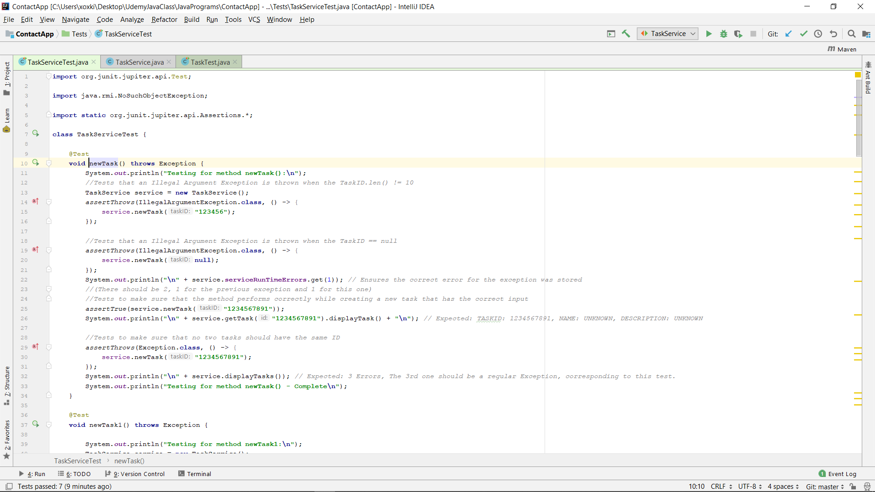
Unit Testing: Code For Invalid Input Unit Test
Notes:
The code of this unit test shows how assert throws can be used to test how a program handles illegal input

Slide 9
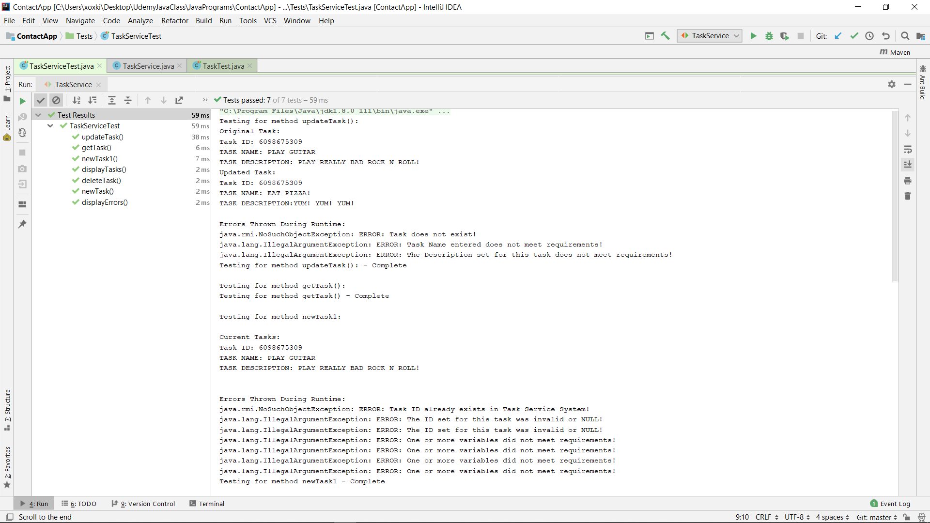
Unit Testing: Testing Against Invalid Input Results
Notes:
This Unit Test displays how efficient Unit Tests can be for testing the vulnerabilities regarding user input.

Slide 10

AUTOMATION SUMMARY

Slide 11
TOOLS
Some of the tools that will be used include: CPP Check, Jet Brain’s IntelliJ IDE automated debugging tools, Unit Tests, CPP Check, built-in tools within Visual Studios, PVS Studios, SQL Inject Me, and SQL Inject Me.
Dev Ops also stresses the importance of following compiler warnings, and code that disables compiler warnings will not be tolerated unless the developer has received written permission .
SQL injection tools will be used in the building and testing phases as well as during the Monitor and Health Check Phases.
Creating secure and sound code is of the utmost importance here at Dev Ops and developing code that “cuts-corners” or is insecure.

Slide 12
RISKS AND BENEFITS
Threat | Benefit | Risk
SQL Injection Attack | Secure database. Prevents potential consequences of an SQL Injection Attack. | More money is spent on security Infrastructure changes and consequences of those changes
Malicious User Access | Secure Network and User Accounts. Prevents unwanted backdoors into system. | More money and resources is spent on updating existing code ensuring all user vulnerabilities are secured.
Improper Coding Protocols | Standardized Coding practices allow for a higher Quality Assurance of Dev Ops Programs and code. | Resources used for training and implementation of new coding practices. Resources spent on enforcement of these practices.

Slide 13
RECOMMENDATIONS
A company wide best coding practice, that is accompanied with employee training on these best practices.
A Defense in Depth Security program that uses elements of the coding practices along with limiting user access and data encryption
Implement Automated Coding Tools to aide Developers write secure and efficient code.

Slide 14
Final Thoughts
Have All Developers Adopt a Secure Programming Practice
Create Clear Code Development Guidelines For Employees To Implement
Create programs With An Emphasis On Data Security And Predictable Programming
Train Developers and Employees On How To Use Automated Tools Properly
Adopt A Policy Where All Programs Must Be Peer Reviewed Before They Are Submitted.

Slide 15
REFERENCES
Build high-quality apps |. (n.d.). Android Developers. Retrieved April 18, 2021, from https://developer.android.com/quality
Rules explorer. (n.d.). Sonar Source. Retrieved May 23, 2021, from https://rules.sonarsource.com/
SEI CERT C++ Coding Standard - SEI CERT C++ Coding Standard - Confluence. (n.d.). SEI CERT C++ Coding Standard. Retrieved May 23, 2021, from https://wiki.sei.cmu.edu/confluence/display/cplusplus/
What’s a practical example of encryption “in use” or “in process”? (2018, March 27). Information Security Stack Exchange. https://security.stackexchange.com/questions/182398/whats-a-practical-example-of-encryption-in-use-or-in-process
PEP 20 -- The Zen of Python. (n.d.). Python.Org. Retrieved April 18, 2021, from https://www.python.org/dev/peps/pep-0020/

